Slide 1
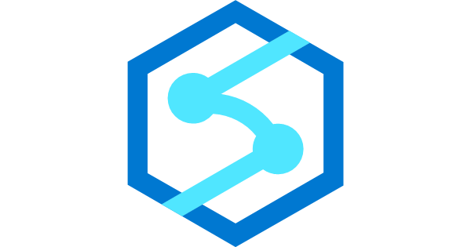
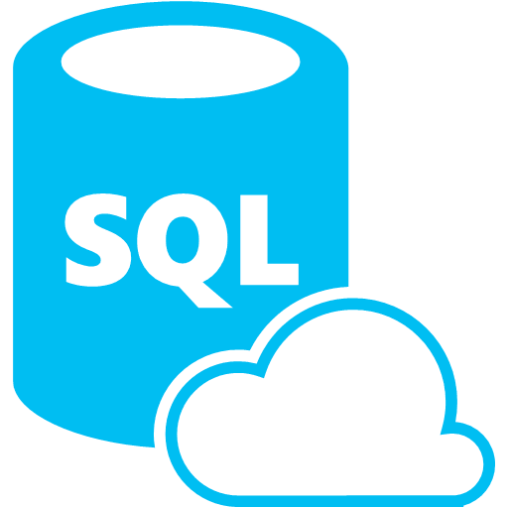
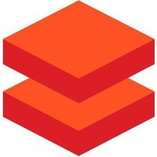
Synapse Analytics SQL Database Databricks
When to choose one?
Why it should be choosen?
Notes:
Technology democratization has led to make available the best features and the killer open-source frameworks to be available in almost all products in a line. Although the cloud provider used in one’s company takes priority, it makes it difficult to choose the best that fits for requirement. In this session, let me share my learnings, how our team analysed different frameworks for use cases. I hope it would help someone to choose the right data analytics tool for his need.

Slide 2




About Me
Dinesh Kumar P
Product Manager,
Reports & Analytics Squad.
https://www.linkedin.com/in/dinesh-kumar-prabakaran
Notes:
Myself currently working as a product manager, for the analytics and reports squad at Kissflow. Coming through 8+ years of the journey around data space, I have involved in implementing B2B SaaS products for Big Data, ETL, and Business Intelligence.

Slide 3
Agenda
* Demystify – Database, Data warehouse, Data Lake, Data Lakehouse.
* Best fit scenarios for choosing DB, DW, DL and DLH.
* Azure Synapse Analytics, Azure Databricks.
* Common features but different in Synapse and Databricks of Azure.
* When to use SQL DB, Synapse, Databricks?
* My use case and what we choose?

Slide 4
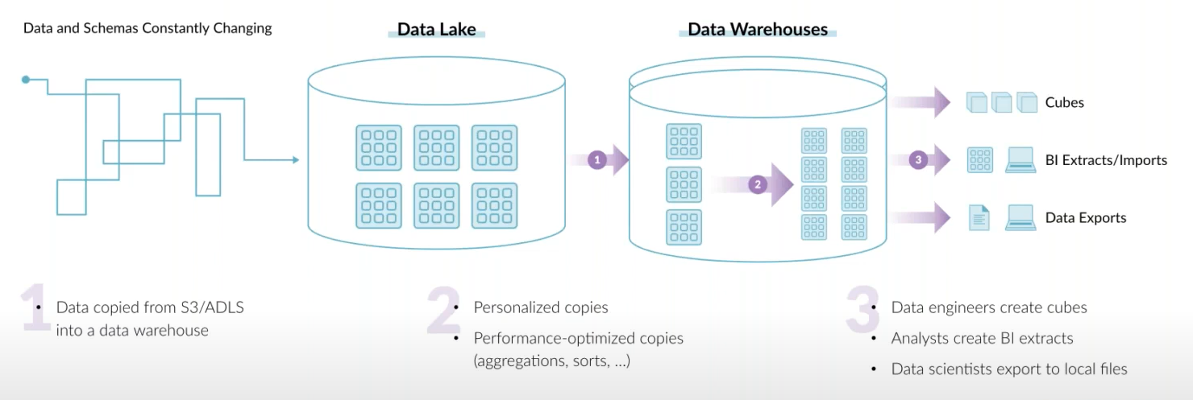
End goal of a data architecture – Allow USER to take SMART decisions
* Don’t choose a data tech, just because you / your team knew it.
* Architect such that copying data is lesser across teams. It is an obstacle for data democratization.
* Define goal based on customers need. (Its not always ML or AI.)
Notes:
Cloud provider that uses sometimes play a vital role in filtering out options. But a general advice is be careful in that. If a service in other cloud provider you feel really useful, take it to the discussion what really different + useful than own provider’s product.

Slide 5
Database Data warehouse Data Lake
- Demystify.
- Best fit scenarios to choose one.
Notes:
This is a crazy and slightly confusing time in the data architecture space. More and more companies are shifting towards data lakes, yet the traditional data warehouse and database continues to provide value, as it has for decades. Now to add that, we have this increasingly popular lakehouse and delta lake concept. The concepts I discuss here will be common that would fit for deciding over data services in Azure as well.

Slide 6
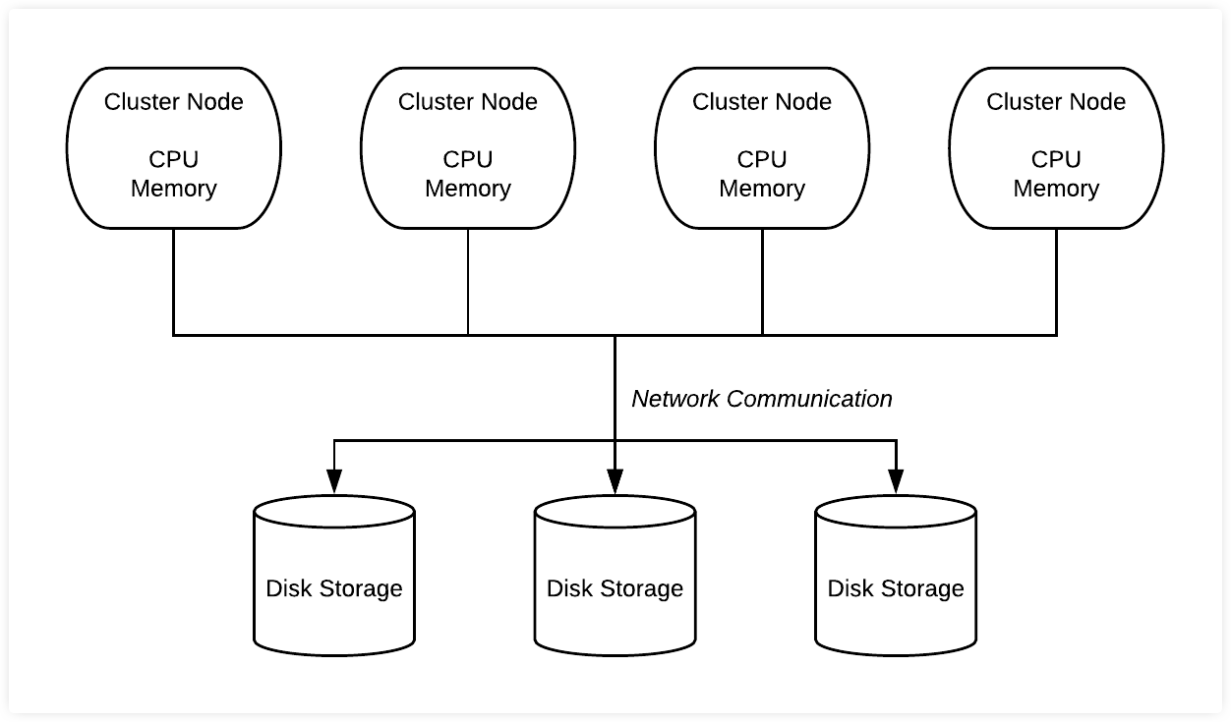
Database
* Co-location of Compute & Storage.
* Recommended for structured data of less than a TB, and the purpose is for OLTP.
* Not recommended for ad-hoc analytics and if there’s more dependency in sharding.
Notes:
Size is not an issue as per a database’s doc. But generally not used for big data.
OLAP cubes are possible in RDBMS, but it need to be prepared before analytics. Which is what I mean for ad-hoc.

Slide 7
DBMS storage models
NoSQL db:
* Graph - .
* Key-value - .
* Document - Frequent schema changes with sub-tables need. (Mongo DB)
* Column-oriented - .

Slide 8
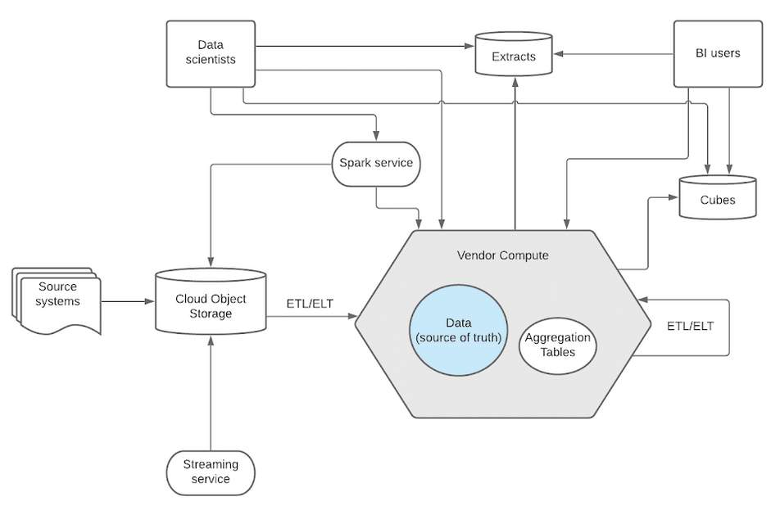
Data Warehouse
* Separation of Compute & Storage.
* Recommended to store structured/processed data.
* Not recommended for unstructured data like image and video into a DW.
Notes:
* Data will be converted to proprietary software’s format. While leaving out, the vendor will export it to a common format like parquet or ORC.
* Snowflake has a data type called ‘BINARY’. Still not recommended. Rather you can decide to store the URL that points to that image/video stored in data lakes like S3.

Slide 9
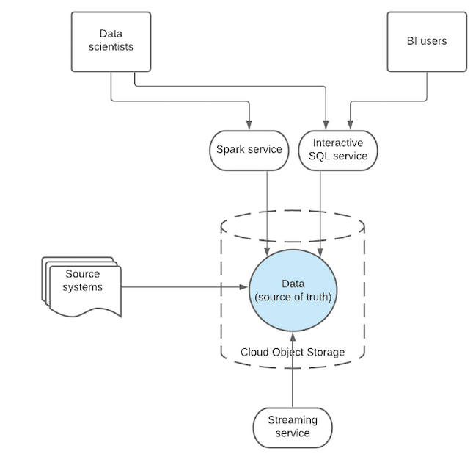
Data Lake
* Separation of Compute & Data.
* Recommended for .
* Not recommended for .
Notes:
* There wont be any conversion or copying to another system. Data relies in 1 single place and all external systems access over same data. So data democratization is good while using data lake.

Slide 10
Why different types exist?
* Each type solves different problem statements.
* When NoSQL came, people talked htat RDBMS will die soon. When BigData hype was at its peak, it was spoken around that the whole DBMS will die. But none happened. Still RDBMS rocks.

Slide 11
Azure Synapse Analytics Azure Databricks
ISP of product.
Common features but how its different in each?

Slide 12
Azure Synapse Analytics
* Data warehouse.
* ISP -

Slide 13
Azure databricks
* Data Lake.
* ISP -

Slide 14
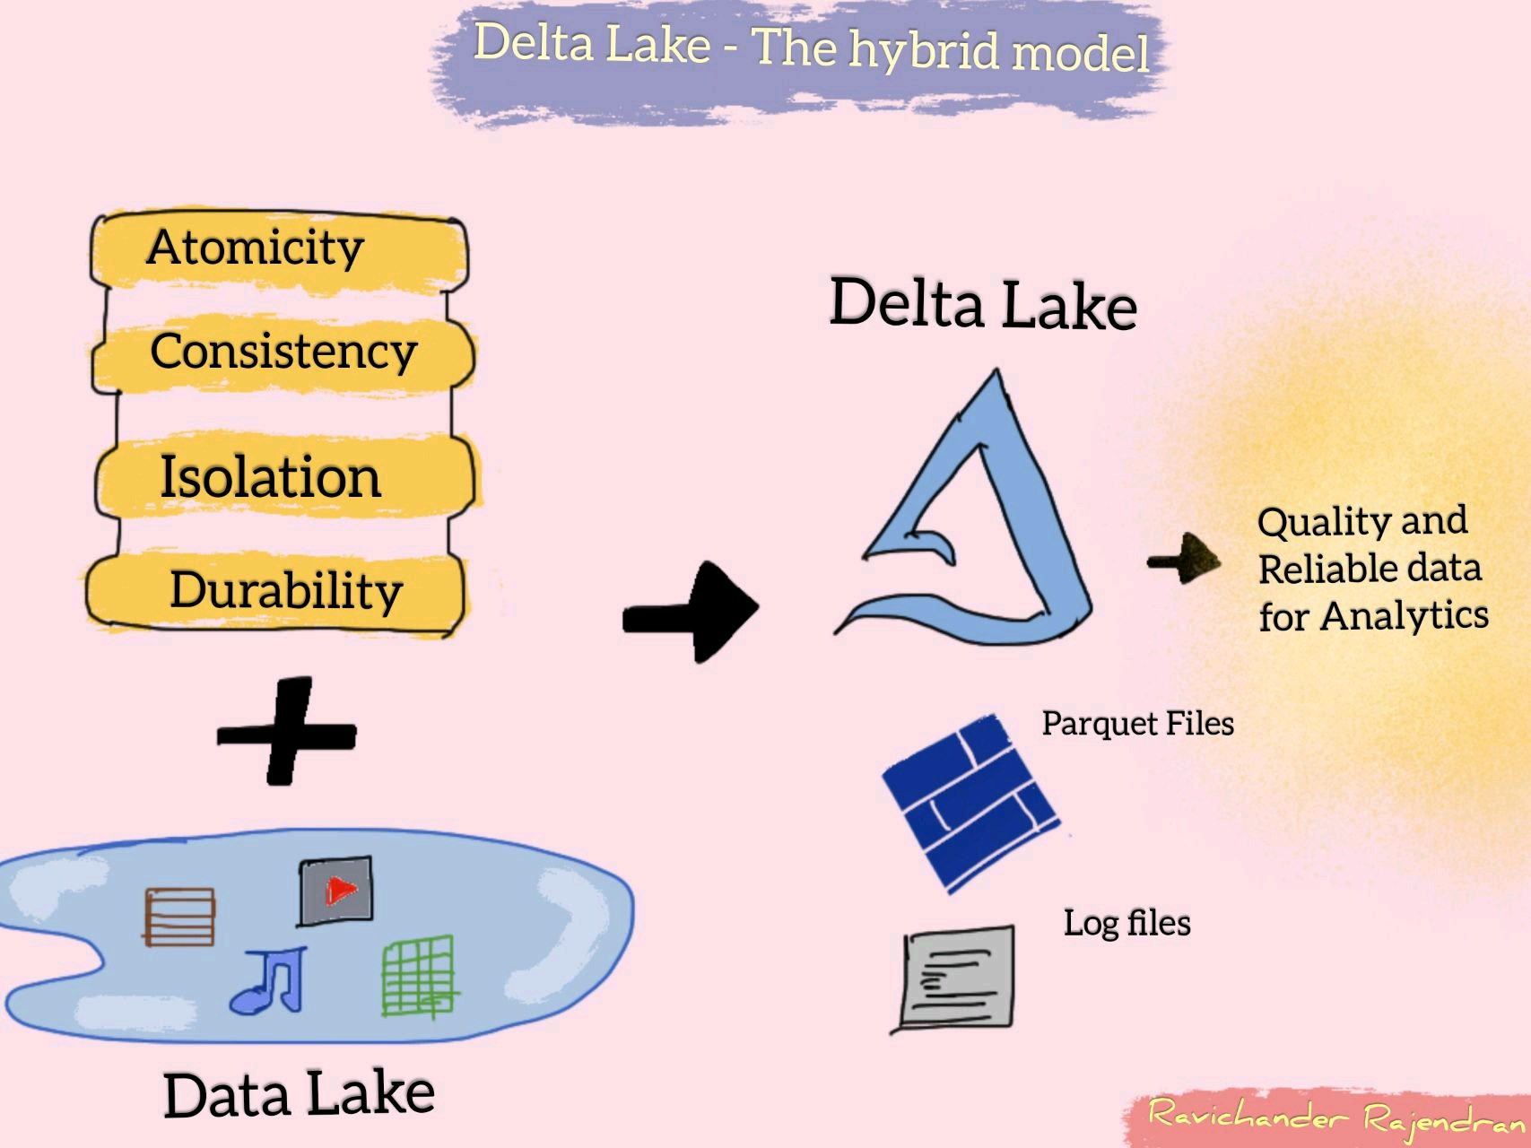
Delta lake – hybrid DATa format

Slide 15
Common features IN SYNAPSE & DATABRICKS
Common feature | Azure Synapse Analytics | Azure Databricks
Apache Spark & Delta Lake | Open-source. | Latest from Databricks.
Jupyter Notebooks | Nteract notebooks. | Databricks notebooks with real time co-authoring and automated versioning.
Access data from a Data Lake | Easier to query from sql scripts and notebooks. | Need to mount and then query.
Storage and Compute separated | SQL on-demand pool | Autoscaling pool

Slide 16
When to use synapse and/or databricks
 | Scenario | Preferred
1 | Ad-hoc data lake discovery by code | Synapse and Databricks
2 | SQL analyses & Data warehousing | Synapse
3 | Self-service BI / Reporting | Synapse
4 | Same data, data scientists play via Spark & data analyst play via SQL. | Synapse
5 | ML/AI development, GPU intensive tasks | Databricks
6 | Dependent tech is much dependent on Delta lake / Spark | Databricks
7 | Local IDEs with GIT kind of developer experience | Databricks
Notes:
Not going to repeat the points which I spoke earlier. I mean core features of Data warehouse / Data Lake / Data Lakehouse.

Slide 17
USE CASE of KISSFLOW
- How we address advanced analytics need apart from general reporting.

Slide 18
use case of
* Kissflow is a pure SaaS product completely cloud managed.
* Nature of product - Customers (business users) develop workflow apps by themself.
* For OLTP - MongoDB Atlas is hosted with 1 DB per customer. Earlier it was MySQL.
* Each customer will have their own schema (data model).
* No separate analytics database as of now.
* Based on our product nature, per customer data won’t be huge.
* Analysed Data Lake, Database and chosen to go with Data warehouse. About choosing vendor the final investigation is going on.
Notes:
MySQL was switched to Mongo for few reasons like – Not restricted over rigid schema, Better sharding, Multi instance need(Dev, staging, prod)
Data warehouse we were thinking to opt is Snowflake over Azure.

Slide 19
What’s next?
Its DATA LAKEHOUSE
* Sting together the best of both worlds – Data warehouse and Data lake.

Slide 20
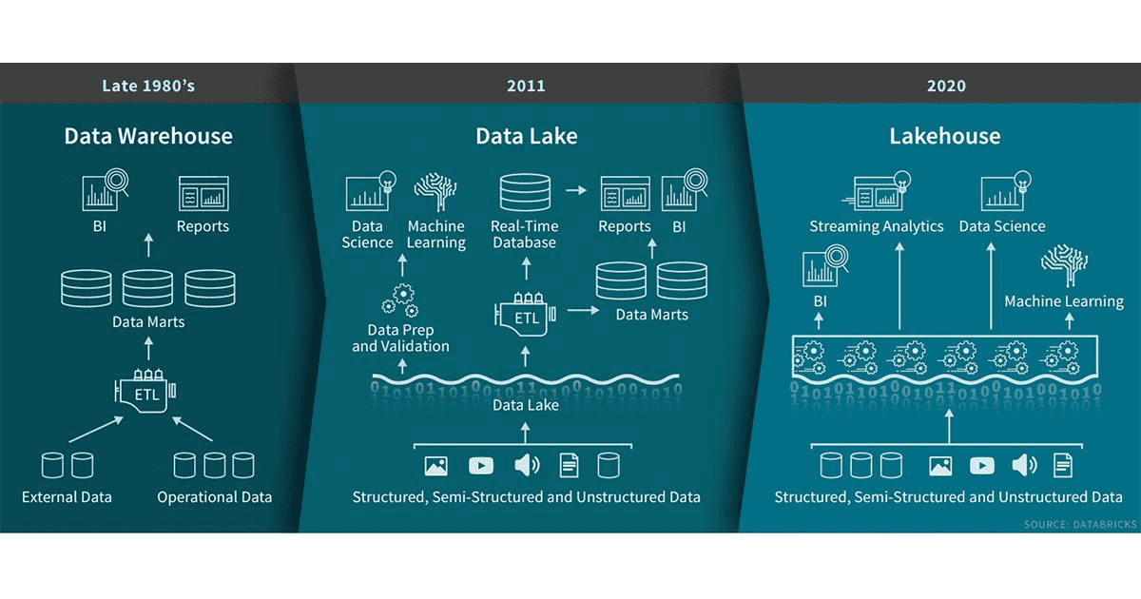

Slide 21
Useful LINKS to dive deep
* Blog post by Ivana Pejeva.
* Debate with proponents of each architecture at Datanova 2021 hosted by Cindi Howson.

